Slide 1
Geocaching 101
Empowering the Newbies
Download this presentation from http://www.geocachingsa.com/geocaching101
Version 2.0 (updated March 2015)

Slide 2
Agenda
Finding Geocaches
Hiding Geocaches
Travel Bugs and Geocoins
Devices
Premium Membership

Slide 3


Agenda
Finding Geocaches
Hiding Geocaches
Travel Bugs and Geocoins
Devices
Premium Membership

Slide 4






Finding Geocaches – plan the trip
Cache types in South Africa
  Traditional (cache is hidden at coordinates)
  Multi-Cache (multiple stages to get to cache)
  Mystery or Puzzle (something to solve/achieve first)
  Earthcache (geological lesson, no container, no log)
  Letterbox Hybrid (contains a stamp, could be puzzle or multi-cache too)
  Wherigo (interact with the environment)

Slide 5




Finding Geocaches – plan the trip
More cache types in South Africa
  Event (meet with geocachers)
  CITO (clean up with geocachers)
  Mega-Event (meet with lots of geocachers)
Grandfathered (no new ones created)
  Virtual (visit the site and prove it)

Slide 6
Finding Geocaches – plan the trip
Difficulty
  1 is in plain site or found in a few minutes
  3 is challenging and could take a good portion of time
  5 is extreme and a serious mental/physical challenge
Terrain
  1 is wheelchair accessible
  3 is off-trail, overgrown, steep elevation changes
  5 is extreme or requires specialised equipment
Get more details at http://www.geocaching.com/hide/rate.aspx

Slide 7
Finding Geocaches – plan the trip
Size
  Micro: Less than 100ml
    Includes nano containers
  Small: 100ml or larger, but less than 1L
  Regular: 1L or larger, but less than 20L
  Large: 20L or larger
  Other: See the cache description for information.
    Unusual geocache containers or deliberately not provided
  Not Chosen:
    No container e.g. event or earthcache
    Deliberately not provided

Slide 8
Finding Geocaches – looking for it
Read the listing
  Including the name
GPSr accuracy
  If hider was 3-5 metres out and your GPSr is 3-5 metres out
    6-10 metres may be as accurate as you will get
  ⅟₁₀₀₀ minute in Gauteng ≈ 1.8m
  Put the GPSr away and just look
You will develop geosense
Hints can help
  Some are obvious, others are cryptic
Stealth
  Be aware of muggles
  Don’t compromise a hiding place

Slide 9
Finding Geocaches – found it
Swap your SWAG
  Trade even or up
Look for Travel Bugs and Geocoins
  Don’t have to trade them, keep them moving
Sign the log!
  If you can’t, get other proof you retrieved the cache
  Most owners will still let you log
Replace it where you found it
  Don’t put it in a “better” hiding place
  Let whoever found it replace it
Log First To Find as soon as possible

Slide 10
Finding Geocaches – log it
Log online
  Tell your story, give the owner more than “TFTC”
  Log your Didn’t Find it logs
Log types
  Found it and signed the log (got your smiley)
  Didn’t find it (DNF) (you looked and didn’t find it)
    Don’t assume it is missing
  Write note (not a find or DNF, need to let someone know something)
    Didn’t look for it for some reason
    Visiting a cache again and not claiming another find e.g. drop trackable
  Needs Maintenance (you found it (part of it), needs some TLC)
    Still need to log the find
  Needs Archived (use sparingly, serious issue (illegal, causes damage,…)
  Will Attend (will be there)
  Attended (was there)

Slide 11
Finding Geocaches – In our geobag
Travel Bugs
GPSr
Spare batteries
Pens and Pencils
Notebook
Gloves
Hand sanitiser
Baby wipes
Sun screen
First aid kit
Torch
Magnet
Compass
Pocket Knife (Tweezers)
Mirror
Spare logsheets
Spare containers
SWAG

Slide 12
GOAT (Glossary Of Acronym Terms)
FTF
CO
HTH
BYOP
GZ
FP
OPOR
SWAG
First to find
Cache owner
Helped to hide
Bring your own pen
Ground zero
Favourite Point
Obvious pile of rocks
Stuff we all get
http://www.geocachingsa.com/glossary for more

Slide 13
Finding Geocaches – other info
Geocachers of South Africa
  http://www.geocachingsa.com/
Groundspeak Help Center
  http://support.groundspeak.com
User Forums
  http://forums.groundspeak.com
Communicate with other geocachers
  Remember to tick “send my email address”
Facebook Group
  Geocaching SA

Slide 14
Agenda
Finding Geocaches
Hiding Geocaches
Travel Bugs and Geocoins
Devices
Premium Membership

Slide 15
Hiding Geocaches – preparing to hide
Read the guidelines
  www.geocaching.com/about/guidelines.aspx
  Don’t bury cache (no digging/creating holes)
  Don’t damage, deface or destroy property
  Don’t harm wildlife or environment (unintentionally too)
  You need permission
Location
  Choose your site and decide why you want to bring fellow geocachers here
  Not too close to another cache
  Not restricted/inappropriate place
  Have a maintenance plan

Slide 16
Hiding Geocaches – what to hide
Plan for a long term hide
Container size appropriate for area
Weather proof
Camouflage
  Design to blend in
  What will muggles think?
  Label or info sheet
Log
SWAG
  Family friendly
  Nature friendly

Slide 17
Hiding Geocaches – Getting coordinates
Coordinates
  Must be accurate
    Required in the guidelines
    Use a reliable GPSr and not an old smartphone
    Don’t rely on online maps or Google Earth
  Take averages over multiple days
    Or at least a few sets
    Some GPSr’s have an averaging function
  Walk away and walk back from different directions

Slide 18
Hiding Geocaches – Create the listing
Not commercial and no “agenda” (political,social,...)
Create listing without enabling so you can check it
Think about your cache name
Provide information about the cache site
You can upload images onto site and include them
Include waypoints (parking, trailheads, entrance, ...)
Include attributes
Consider adding Geochecker if it is a puzzle
Hide container in place before enabling listing
Reviewer notes
  Reviewer is your friend, work with them

Slide 19
Hiding Geocaches - Maintaining
Visit cache when issues reported
Log types
  Owner Maintenance (fixed it)
  Disable (deactivate until I fix it)
  Enable (activated because I fixed it)
  Archive (taking cache out of action permanently)
    Remember to remove the container

Slide 20
Agenda
Finding Geocaches
Hiding Geocaches
Travel Bugs and Geocoins
Devices
Premium Membership

Slide 21
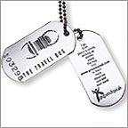

TravelBugs and GeoCoins (Trackables)
What they look like
Check their mission
Waiting for them to be in the correct cache
  Give previous carrier chance to drop it before you grab
Logging
  Discover
  Retrieve/grab
    Done from the Trackable’s page
  Dropping
    Done with your log for the cache
Consider keeping a list of Trackable numbers

Slide 22
Agenda
Finding Geocaches
Hiding Geocaches
Travel Bugs and Geocoins
Devices
Premium Membership

Slide 23
Which Device?
GPSr – Handheld | GPSr – Car | Phone/Tablet
Good battery life | OK battery life | OK battery life
Can carry spare batteries | Need a portable charger | Need a portable charger
Durable and rugged | Not so durable and rugged | Don’t drop me /get me wet
Accurate | Accurate | Recent phones accurate
Means an additional device | Means an additional device | No extra device
Can’t update info in field | Can’t update info in field | Update info in the field
Can only create field notes | Can only create field notes | Can log as you find it
You can use all three:
  Car GPSr to drive to the location/waypoint
  Phone for quick finds or new caches and for quick logs
  Handheld GPSr for hikes or long caching days

Slide 24
Which App?
Groundspeak app
Other apps for finding geocaches
  Look for online and offline access
  Search functionality
  Logging functionality
Internet on your phone
Other apps for supporting your geocaching
  Solve puzzles
  Work out multicache coordinates
Wherigo app

Slide 25
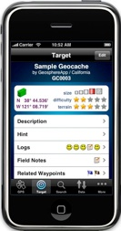
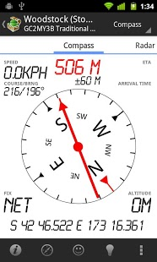
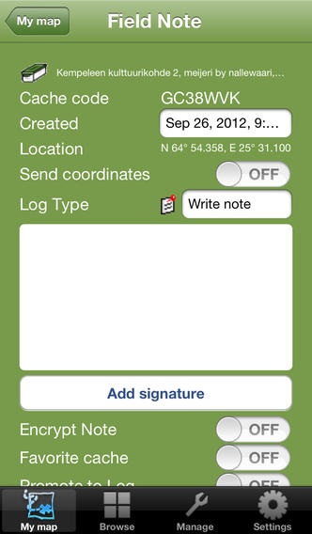
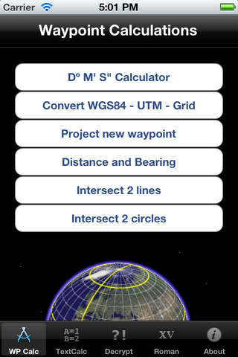
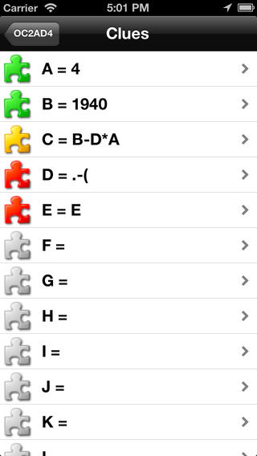
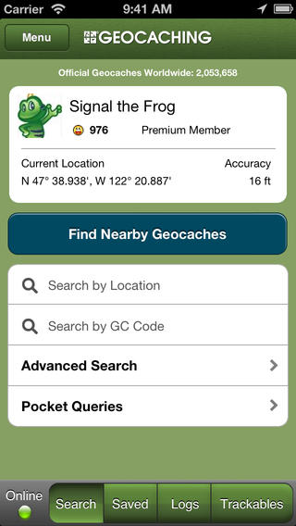
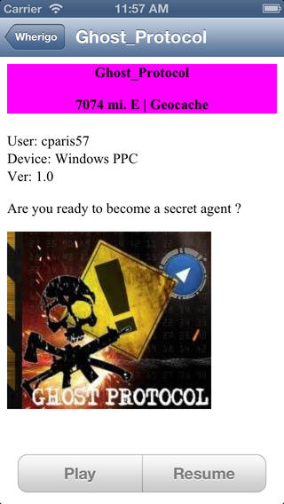
Some app examples
Geosphere
CacheSense
Geo Bucket
iGCT
Geocaching Buddy

Slide 26
Logging on the fly
Field note or actual log
Keeps record of finds
  Date and time
  Make notes in field note
Can log a brief note/log when you find it
  Update later
  Log FTF as you find it
Keep Trackable’s up to date

Slide 27
Agenda
Finding Geocaches
Hiding Geocaches
Travel Bugs and Geocoins
Devices
Premium Membership

Slide 28
Premium Membership
Pocket Queries
Favourite Points
Notifications
Lists
Premium Member only caches
Statistics

Slide 29
Questions?

